Slide 1
Citi® Present & Pay
Customer User Guide

Slide 2
Contents
User Registration and Login
Home Page
Advanced Search and Filters
Manage Users
Manage Contacts
Open Bills & Payments
Exports
Payment on Account
Payment History
Manage Disputes
Closed Bills

Slide 3
User Registration & Login
1
December 9, 2021. Present and Pay Customer User Guide

Slide 4
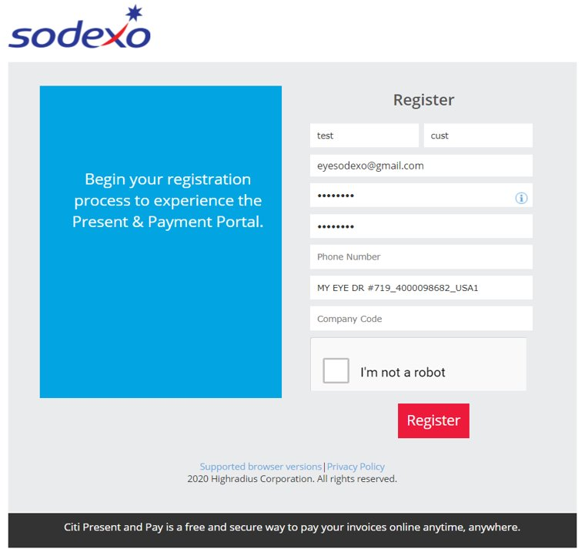
Register for Citi® Present and Pay using the link e-mailed to you from Sodexo:
After clicking on the invitation link, you will be redirected to the Registration Page with all the required fields pre-populated.
Step 1: Create a password, confirm it and enter the other requested information.
Step 2: Click Register. After successful registration, you will be redirected to the login page you will use whenever you want to access the Present & Pay platform.

Slide 5
Home Page Section
2
December 9, 2021. Present and Pay Customer User Guide

Slide 6
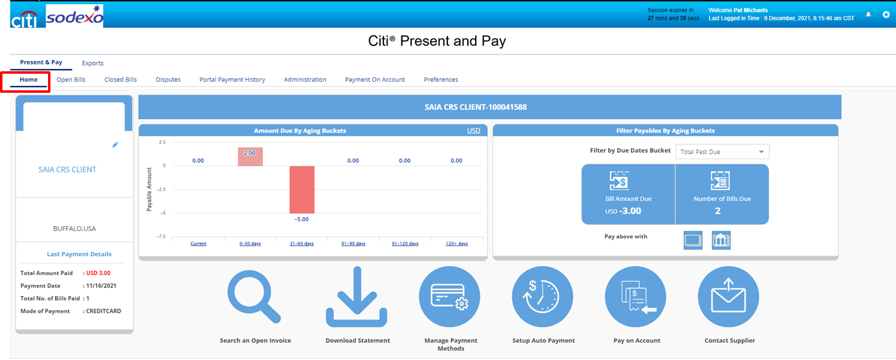
Home Page
The home page provides you with an overall summary of your invoices within the Present & Pay platform.

Slide 7
Home Page Features
From the home page you can……
See your customer details
See the amount due by aging buckets
Filter payables by aging buckets
Use shortcuts to:
Search for open invoices
Manage payment methods
Set up autopayments
Pay on account
Contact supplier (Sodexo)

Slide 8
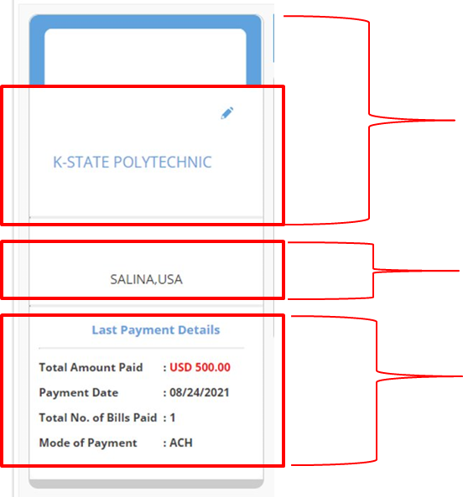
Home Page: Customer Details
On the left-hand side of the home page is a summary of customer information
Your company name
A place for your company’s logo if you’d like to add it
Your customer address
Details related to your last payment made via the Present & Pay platform to Sodexo

Slide 9
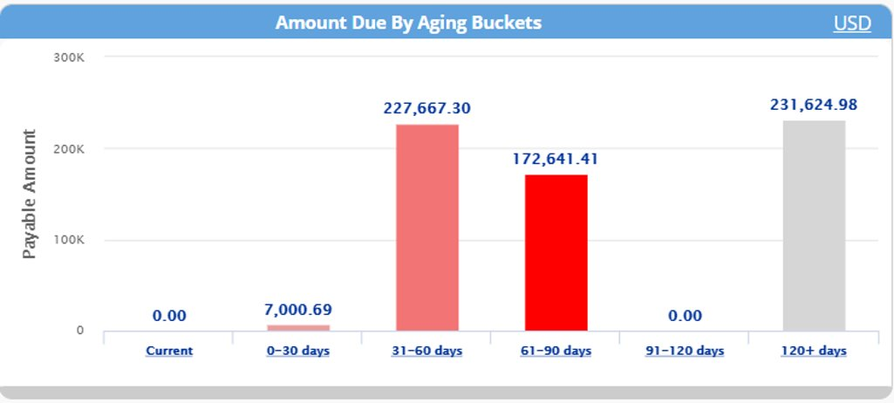
Home Page: Amount due by aging buckets
In the center left of the home page you can view the amount due by aging buckets
Click on the graph bar to see the open bills that are included within each aging bucket

Slide 10
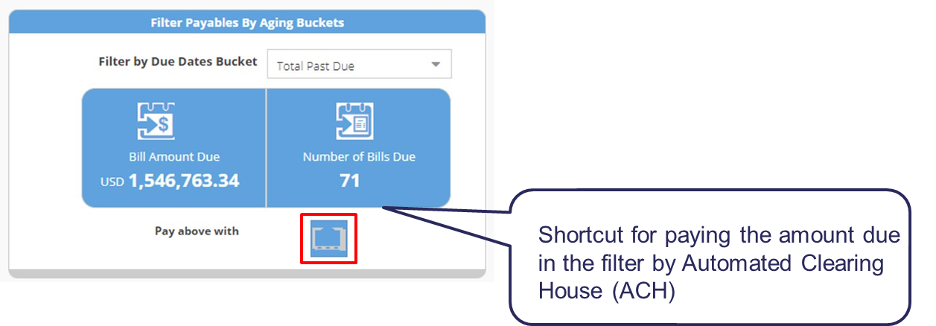
Filters payable by aging buckets
This section provides the amount due and number of bills within the selected filter.
By clicking on payment method, it will redirect you to a pop up to pay open bills.

Slide 11
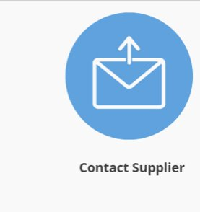
Shortcuts
Search open invoice(s) directly by entering the invoice number(s) separated by “,”. It will redirect to the open bills tab
Redirects to the Manage Bank accounts section under the Administration tab
A pop up appears to contact Sodexo
Setup Autopay
Redirects to the Payment on Account screen

Slide 12
Contact Supplier Shortcut
Use the “Contact Supplier” function to report an invoice related issue to Sodexo. When you click on the “Contact Supplier” button, a pop up appears asking you to choose the type of issue before proceeding further. In this case, the “supplier” = Sodexo

Slide 13
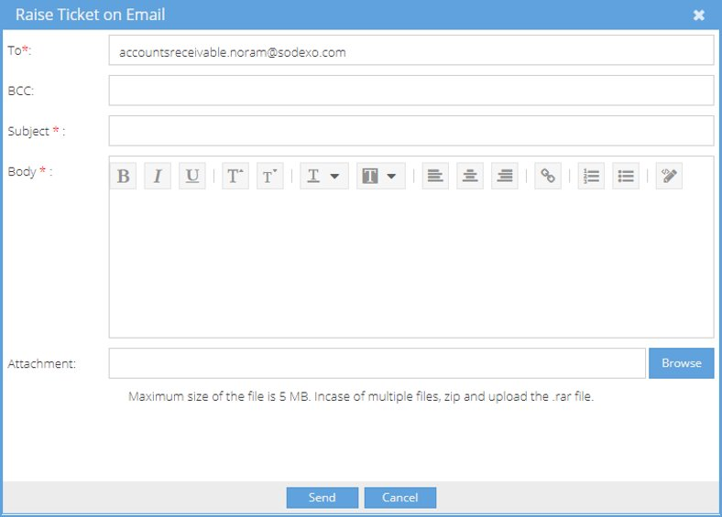
Home Page Functionalities- Shortcut- Contact Supplier
Once you’ve selected the type of issue, a window will open that allows you to e-mail Sodexo about it.

Slide 14
Advanced Search and Filters Section
3
December 9, 2021. Present and Pay Customer User Guide

Slide 15
Advanced Search
The Advanced Search panel is a common feature across the tabs which you can use to filter the information you want to review
Click on the Advanced Search button to bring up the filter panel.
Fill the relevant fields to pull the data you want to view
You can also use an asterisk(*) to search for a pattern. For example, if you search for Invoice Number *100*, the filtered invoiced would be of Invoice Numbers- 000100000, 222100222
Once you’ve filled out the necessary fields, click on Search to view the results.

Slide 16
Creating and Saving Filters
You can also save commonly used filters to easily access again in the future.
Using the Advanced Search panel, fill out the fields you want to use in your filter
Click on the Save Filter button to save the combination.

Slide 17
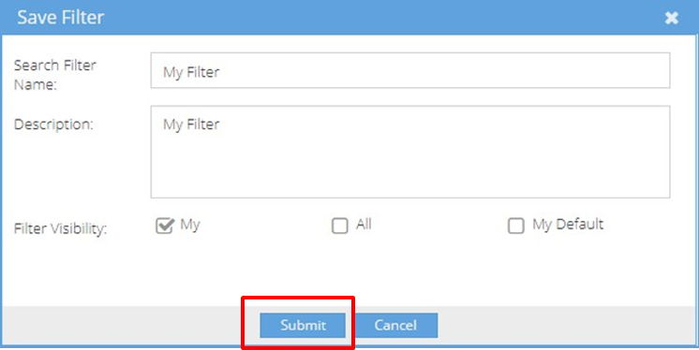
Creating and Saving Filters (continued)
After you click on Save Filter, enter a name for the filter and hit submit so that you can easily use it again
Once you’ve saved a filter, it will be available for use in the Search Filter dropdown.
You can also select a filter to edit or delete, using the filter icons to the right of the search filter drop down

Slide 18
Manage Users Section
4
December 9, 2021. Present and Pay Customer User Guide

Slide 19
Manage Users
Use the Administration page to view and manage the Present & Pay users from your organization
Navigate to Present & Pay > Administration> Manage Users.

Slide 20
Manage Contacts Section
5
December 9, 2021. Present and Pay Customer User Guide

Slide 21
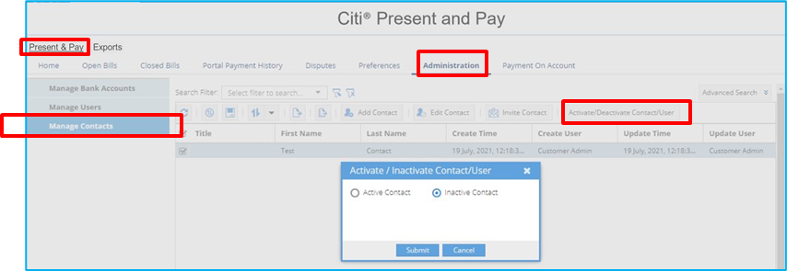
Manage Contacts- Activate/Deactivate Contact
The manage contacts feature allows you to activate/deactivate your contacts to ensure correspondence notifications are being properly received.
Step 1: Navigate to Present and Pay> Manage Contacts
Step 2: Select a contact which needs to be activated/deactivated
Step 3: Click Activate/Deactivate Contact/User button– a pop up will appear
Step 4: Select Activate or Deactivate Contact and click Submit
The flag will change to Yes under Active column when a contact is activated or deactivated.

Slide 22
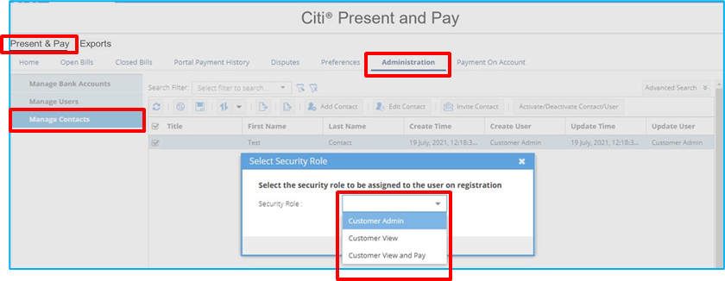
Manage Contacts- Invite Contact
This feature allows you to invite contacts from your organization to onboard to the Present & Pay platform. Security roles can be assigned as either Admin, View & Pay, or View.
Step 1: Navigate to Present & Pay>Administration > Manage Contacts
Step 2: Select a contact which needs to be invited
Step 3: Click Invite Contact button– a popup will appear
Step 4: Select a Security Role from the dropdown and click Submit
The Contact will receive an email with a link to the Registration page.

Slide 23
Open Bills & Payments Section
6
December 9, 2021. Present and Pay Customer User Guide

Slide 24
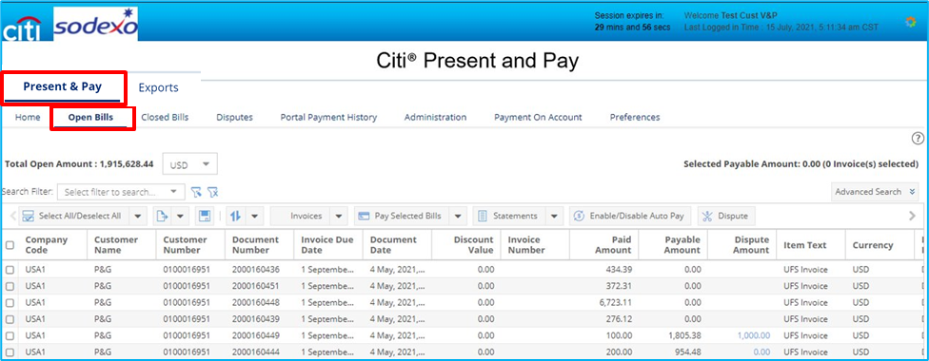
Open Bills and Payments
Open Bills provides an overview of all your invoices and lets you make payments, raise disputes, access statements and view the payment status of your invoices. Navigate to Present & Pay>Open Bills
Through the Present and Pay platform, you can view your invoice supporting documentation and pay your invoices in one convenient location.
*Amounts will be displayed in local currency (USD/CAD)

Slide 25
Open Bills and Payments Features
You can perform the following functions using the Open Bills tab:
View/download invoices
Pay by ACH
Schedule Payments
Enable/Disable Auto Payments
Create Disputes
Download Statements
Configure AutoPay for Payment on Account (POA)

Slide 26
Open Bills
Total payable amount and number of invoices selected are shown in upper right corner
Click on a column name to sort the column
A. Export Pages: Click on the dropdown to export current/all pages
B. Save Layout: Layout can be customized by moving field (columns) right or left. Click on save layout button to save changes.
C. Save or Delete sort the sort you are using

Slide 27
Open Bills (continued)
At the bottom of the Open Bills tab, you will find these functions:
Back Arrow Buttons: Use these to move to the previous pages.
Forward Arrow Buttons: Use these buttons to move to the next page.
Refresh: Use this option to refresh the page.
Refresh Sort: Use this option to reset any sorting that’s been applied to the columns on the page.

Slide 28
View/Download Invoice
Navigate to Present & Pay > Open Bills to view, download and/or e-mail your Invoice PDFs
Step 1: Select an invoice
Step 2: Click on View Invoice
*Invoice PDF will be opened in a new tab. You can download a copy of Invoice PDF. To view the Invoice details, click on View Details button. A pop up will appear with invoice details.
Step 3: Click on Correspondence for emailing the PDF to the e-mail ID(s) of your choice.

Slide 29
Manage Bank Accounts
Manage Bank Accounts Menu allows you to manage the electronic payment methods, such as bank accounts.
Step 1: Navigate to Present & Pay > Administration
Step 2: Click Manage Bank Accounts
This tab helps you to Add and Delete Bank accounts from the Present & Pay platform.

Slide 30
Manage Bank Account Functionalities
Add a Bank Account
Delete a Bank Account
Enable/Disable for Merchants

Slide 31
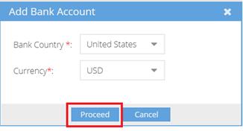
Add a Bank Account
Step 1: To add bank details, click on Add. A pop up will appear with Bank Country and Currency auto populated
Step 2: Click on Proceed to continue
*Any bank account added can be marked as primary.

Slide 32
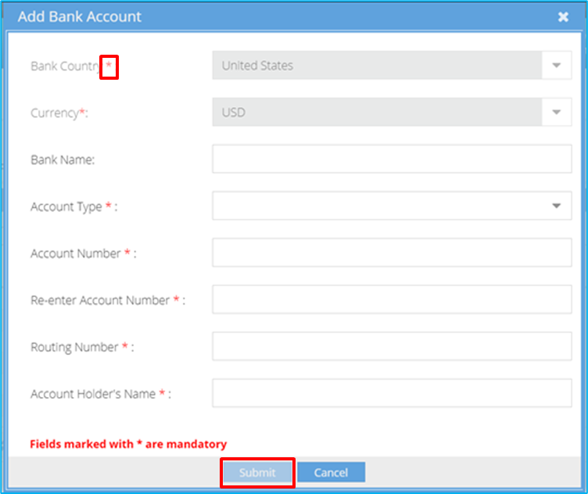
Add a Bank Account- Enter Details
Step 1:Enter all mandatory details
Mandatory fields are denoted with an asterisk (*)
Step 2: Click Submit
The new Bank Account will under Manage Bank Accounts

Slide 33
Delete Bank Account
To delete a bank account:
Step 1: Select Bank Account record to be deleted by using the check box
Step 2: Click Delete button—a pop up will appear
Step 3: Click Yes to delete the bank account from the Present & Pay platform
The Bank Account will be deleted.

Slide 34
Enable/Disable Bank Account for Merchant
To make a bank account accessible to Sodexo, proceed as follows:
Step 1: Select Bank Account by clicking the check box
Step 2: Click Accessible by Merchant button
Step 3: Click on Enable from the dropdown
These steps may also be followed to Disable a bank account for Merchant

Slide 35
Pay By ACH Using a NEW Bank Account
To add and save a new bank account and pay your invoices by ACH, follow these steps under Open Bills
Menu:
Step 1: Select the AR record- you may also select multiple records by clicking on the boxes to the left
Step 2: Click on Pay Selected Bills
Step 3: Click on Pay by ACH
Select Pay by ACH from the pop up that appears

Slide 36
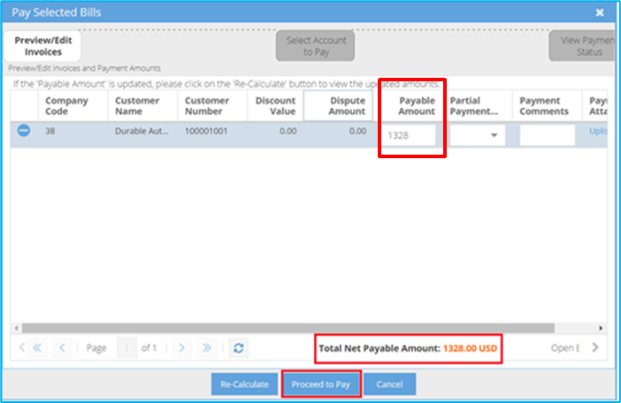
Pay By ACH- Preview
Step 1: Check the Payable Amount and enter any applicable Comments (for instance, if you are making a partial payment you would note this in the comments section)
Step 2: Click on Proceed To Pay - A pop up will appear

Slide 37
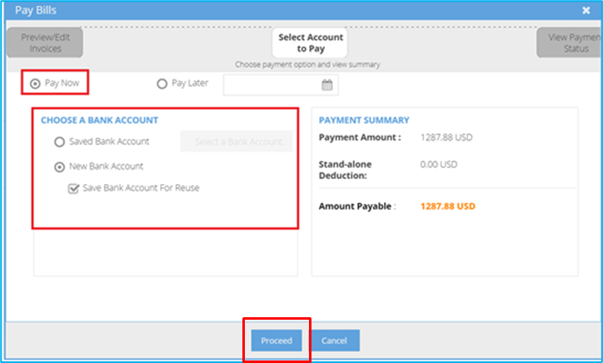
Pay By ACH- Payment Summary
Step 1: Click on the "Pay Now" button
Step 2: Select a bank account from the dropdown
Step 3: Click New Bank Account. Click on Save Bank Account For Reuse to save the details for future use.
Step 4: Click Proceed
A pop up will appear

Slide 38
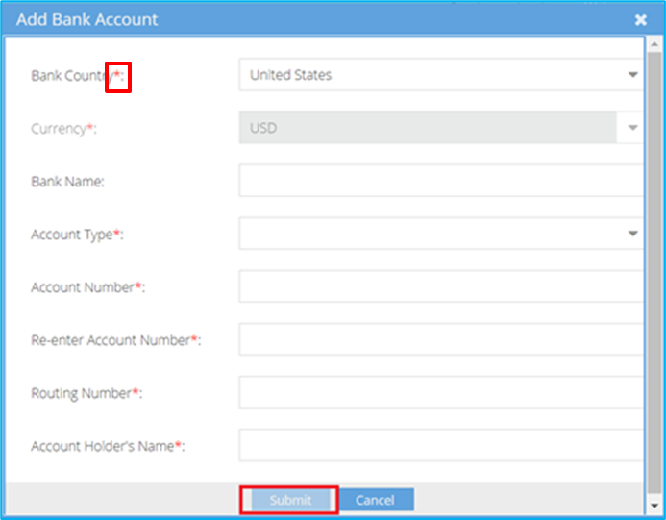
Pay By ACH Using a NEW Bank Account- Add Bank Details
Step 1: Add all the mandatory details
Mandatory fields are denoted with an asterisk (*)
Step 2: Click on Submit to save the bank details
Step 3: Proceed with the payment using this bank account

Slide 39
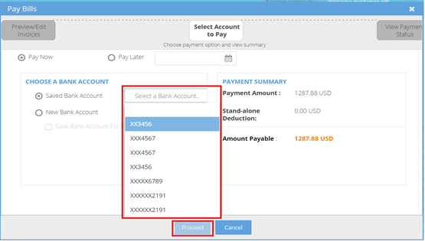
Pay By ACH- Using an EXISTING Bank Account
To pay your invoices by ACH using an existing bank account, follow these steps:
Step 1: Select a bank account from the dropdown
Step 2: Select the bank account details from dropdown
Step 3: Click on Proceed to continue

Slide 40
Pay By ACH- Email/Print Receipt
Payment Status will show Success. This means that the payment was successful.
Step 1: Click Email Receipt to send receipt by entering the required email address
Step 2: Click Print Receipt to generate the receipt
Step 3: Click Close to close the pop up

Slide 41
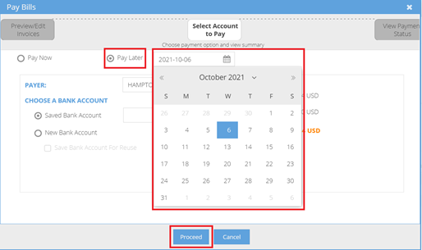
Pay By ACH: Schedule Payment for a Future Date
To schedule payment for a future date, select the invoice to be scheduled from Open Bills. Click Pay Selected Bills > Pay by ACH> Proceed to Pay
Step 1: Click on the "Pay Later" button
Step 2: Select the date for the payment to be scheduled
Step 3: Select a bank account from the dropdown
Step 4: you may select a saved bank account or add a new bank to pay for the scheduled payment
Step 5: Click Proceed and follow the same steps previously described to pay an invoice

Slide 42
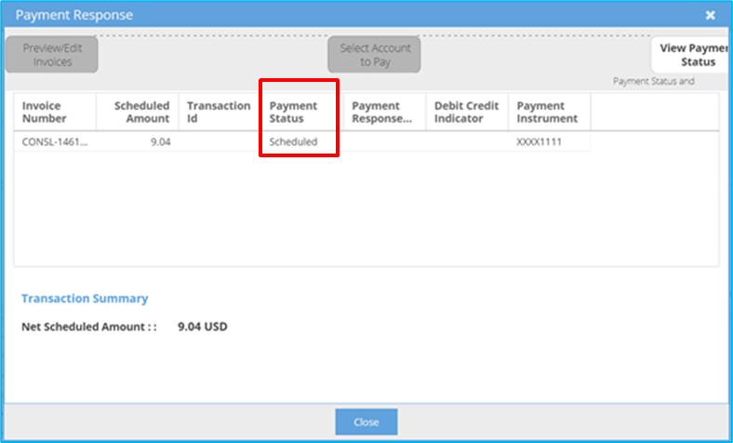
Pay By ACH- Pay Later
Payment Status will show Scheduled. The payment will be processed on the date is was scheduled for.
Click Close to close the pop up

Slide 43
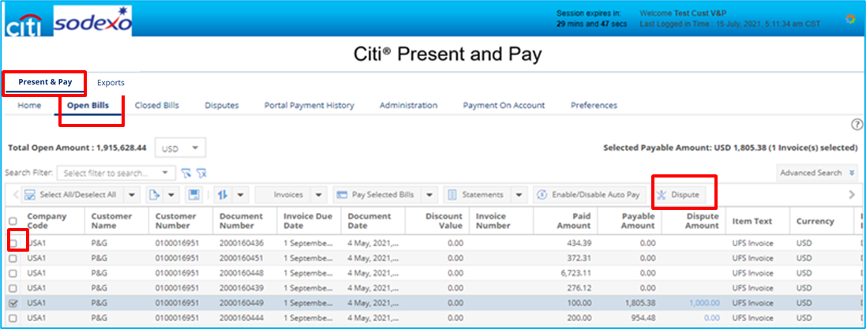
Disputes
To create a dispute on any invoice due to a possible discrepancy, please follow these steps:
Step 1: Navigate to Present & Pay>Open Bills
Step 2: Select an Invoice
Step 3: Click the Dispute button - A pop up will appear
*You may select multiple invoices under by clicking on the boxes to the left

Slide 44
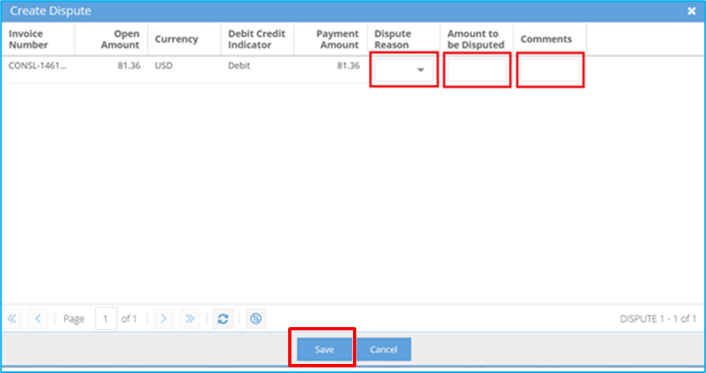
Create Disputes- Add a Dispute Reason and Amount
Step 1: Select Dispute Reason from dropdown
Step 2: Enter Amount to be disputed and Comments, when applicable
Step 3: Click Save to create dispute(s)

Slide 45
View Disputes
You may view your dispute by navigating to Present & Pay> Disputes
Related attachments can be uploaded by clicking on "Upload"
On the Open Bills page : Present & Pay> Open Bills view, the Dispute Amount will appear under “Dispute Amount” and Payable Amount will be reduced accordingly

Slide 46
Download Statements
To download your statement, navigate to Present & Pay > Open Bills
Step 1: Click on Statements
Step 2: Click on Download Statement
The statement will open in a new window
*Amounts will be displayed using local currency (USD/CAD)

Slide 47
Exports Section
7

Slide 48
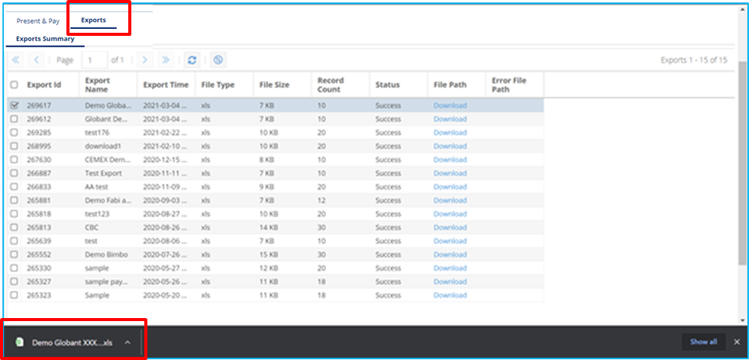
Exports
Records exported using Export and Export All features from any of the tabs within the application will be available in Exports tab as downloadable links.
Exported files are labeled with an “Export Name” that you assigned while exporting the file.
Click on Download to save the data to your desired location

Slide 49
Payment on Account Section
8

Slide 50
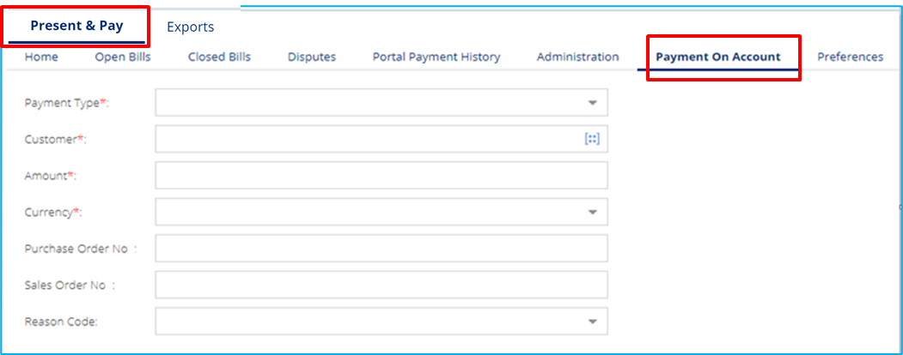
Payment on Account (POA)
Payment on Account allows you to make a payment without referencing any invoice. You simply enter all required details, including; Payment Type, Customer, Amount and Currency to make the ACH payment.
Navigate to Present & Pay > Payment On Account
Step 1: Enter the necessary fields
Step 2: Click Submit

Slide 51
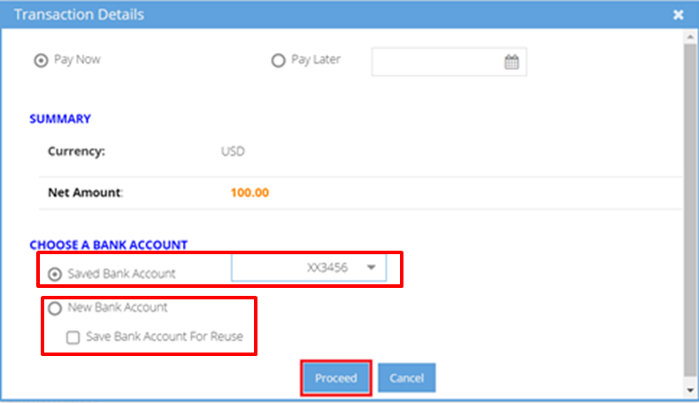
Payment On Account- ACH
Step 1:
Select bank account from Select the Payment Method drop-down list
Step 2:
To add a new bank account, select New Bank Account. Enable Save Bank Account For Reuse checkbox to save bank details for future payments
Follow same steps shown in Open Bills > Pay Bills by ACH case

Slide 52
Payment History Section
9

Slide 53
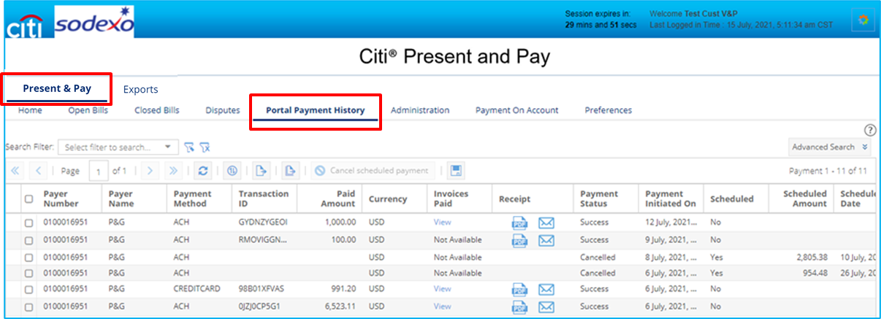
Payment History
The Payment History tab displays the list of your payments to Sodexo via the Citi® Present & Pay platform. The screen displays all relevant information about the payments made including Payment Date, Paid Amount, Payment Method, Scheduled Date, and other informational data.

Slide 54
Payment History Features
View Payment Details made through Present and Pay
View/E-mail Payment Receipts
Cancel Scheduled Payments
Export Payment Details

Slide 55
View or E-mail Payment Receipt
To view or e-mail the payment receipt for a payment, navigate to Present & Pay > Portal Payment History and select a transaction where you can then:
View Details: Click View for payment details. A new pop up will open showing payment details
View Payment Receipt: Click PDF icon to open payment receipt. A new tab will open with payment receipt which can be downloaded in PDF format
Email Payment Receipt: Click on envelope icon to send payment receipt by entering required email address

Slide 56
Cancel a Scheduled Payment
To cancel a payment scheduled for the future, navigate to Present & Pay > Portal Payment History
Step 1: Select a transaction which is already scheduled. To view all scheduled transactions, go to Advanced Search > Select "Scheduled" from the dropdown for Payment Status field and search
Select the payment you want to cancel
Step 2: Click Cancel Scheduled Payment button to cancel the scheduled payment and the Payment Status will change to Cancelled

Slide 57
Export Data
To export the data to a file, navigate to Present & Pay > Payment History
Step 1: Click Export Current Pay/ Export All Pages button—a pop up will appear
Step 2: Enter the Export Name
Step 3: Click More Options to select File Type
Step 4: Click Submit
Step 5: Select the Exports tab at the top of the screen, locate the export name and download the file to the location of your choice

Slide 58
Manage Disputes SectionSection
10

Slide 59
Manage Disputes
The Disputes tab contains list of all invoices with disputes and their status.
You may withdraw your dispute using the steps that follow

Slide 60
Creating a Dispute
To create a dispute, navigate to the Open Bills tab
Step 1: Click on the Invoice you wish to Dispute
Step 2: Select the Dispute button
A popup will appear to fill out all applicable fields to log a dispute.

Slide 61
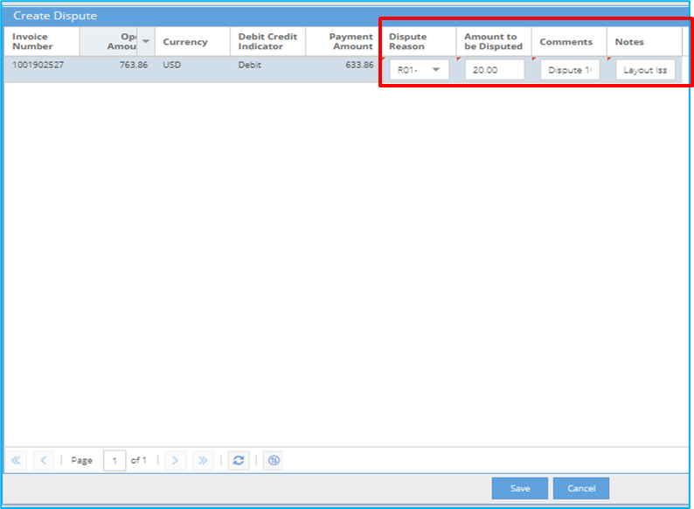
Creating a Dispute (continued)
Once the Create Dispute popup appears, you will need to fill out all applicable data to log the dispute.
Step 1: Fill out all applicable fields
Dispute Reason
Amount to be Disputed
Comments
Notes
Step 2: Click Save

Slide 62
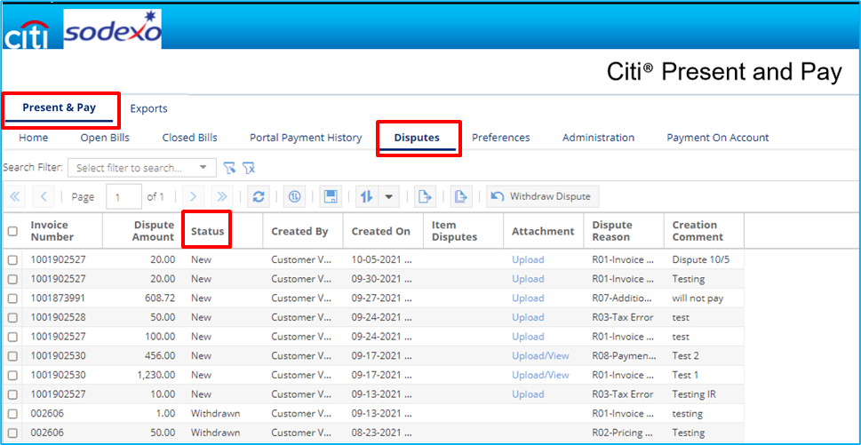
Checking Dispute Status
To check on the status of a dispute, click on the Disputes tab
All disputes logged and their status can be found on this page

Slide 63
Withdraw Disputes
To withdraw a dispute, navigate to Present & Pay > Disputes
Step 1: Select a disputed invoice to be withdrawn by using the check box
Step 2: Click on Withdraw Dispute—a pop up will appear
Step 3: Click Yes to withdraw the dispute
The dispute status will change to Withdrawn

Slide 64
Closed Bills Section
11

Slide 65
Closed Bills
The Closed Bills tab displays all invoices that have been closed
Navigate to Present & Pay > Closed Bills

Slide 66
Thank You for Using Citi® Present and Pay A better way to view, manage and pay your Sodexo invoices.
If you need further assistance, please reach out to a member of Sodexo’s Comprehensive Receivables Solution team at: SodexoCRSTeam.Noram@sodexo.com

